Slide 1
CHARACTERIZATION
DIRECT - the narrator specifically TELLS the reader what a character is like.
INDIRECT - the narrator SHOWS the reader something about the character.
CLIP 1
CLIP 2

Slide 2
CHARACTERIZATION
How do we learn about characters in a story?
Physical appearance - INDIRECT
What the character says to him/herself and to other characters - INDIRECT
What the character does – Sometimes actions speak louder than words! - INDIRECT
What the narrator or other characters say about the character - DIRECT

Slide 3
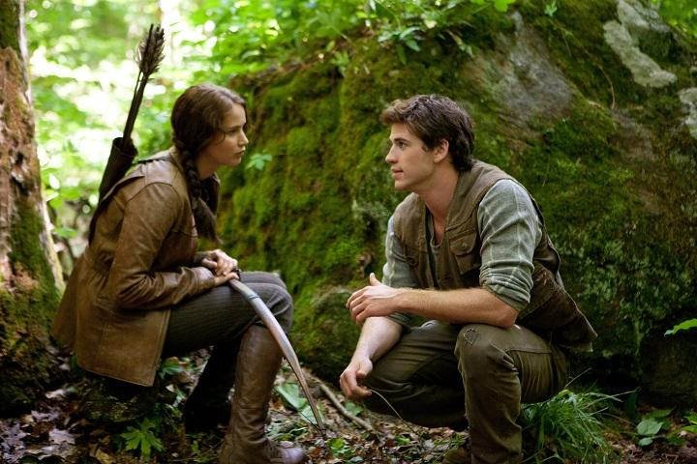
APPEARANCE
What would you infer about this character from her appearance?

Slide 4
APPEARANCE
How about now? Does the change her physical appearance indicate something about the character?

Slide 5
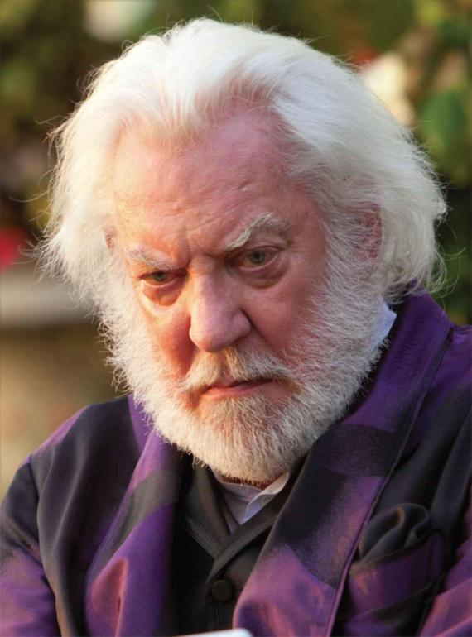
WHAT CHARACTERS SAY
What does this quote reveal about his character?
President Snow: Hope, it is the only thing stronger than fear. A little hope is effective, a lot of hope is dangerous. A spark is fine, as long as it's contained.
Seneca Crane: So...
President Snow: So, contain it!

Slide 6
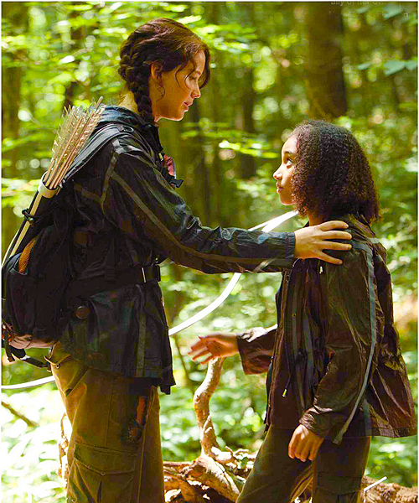
ACTIONS
What does the underlined action reveal about Katniss?
Katniss: Unexpectedly, Rue
throws her arms around
me. I only hesitate a moment
before I hug her back.

Slide 7
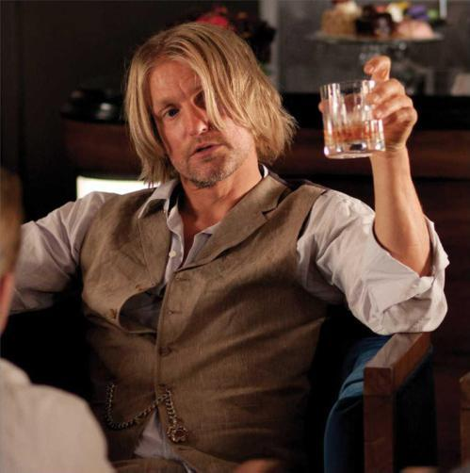
WHAT IS SAID ABOUT A CHARACTER
What does this quote reveal about Haymitch?
Katniss: With all that alcohol in
him [Haymitch], it’s probably
not advisable to have him
around an open flame.

Slide 8
CHARACTER TRAITS
Internal (can’t see) | External (can see)
Dangerous | Cute
Curious | Tall
Fearless | Doctor
Studious | Athlete
Cheerful | Ugly
Adventurous | Smelly
Determined | American
Talented | Large
Restless | Blonde
Loving | Wealthy
Brave | Well-dressed

