Slide 1
Aha Moment

Slide 2
STOP! Notice and Note
Signpost Two–
Aha Moment
WHY USE IT? To examine what the character is learning – focus on conflict and theme.

Slide 3
STOP! Notice and Note
When you notice a character suddenly realizes, understands, or finally figures something out, note it!
These are important moments in the plot of a story!

Slide 4
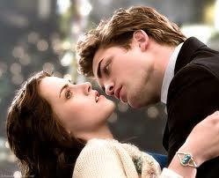
EXAMPLE:
Bella (who is in love with Edward)
realizes that he is a Vampire!

Slide 5
STOP! Notice and Note
THEN WHAT?
After you note an Aha Moment, ask yourself the following question:
How might
this change
things?

Slide 6
STOP! Notice and Note
The answers to that
question can help you make
inferences about the conflict and theme!
So, how might this change
things in the Twilight story?

Slide 7
COPY THE FOLLOWING REMINDERS:
Always, STOP! Notice and Note:
Aha Moment – When a character suddenly realizes, understands, or finally figures something out.
Note the part of the text.
THEN, ask yourself the question: How might this change things?

Slide 8
DARK THEY WERE AND GOLDEN EYED
EXAMPLE: PAGE 469
What is suddenly
realized on this page?
How might this
change things?

